Slide 1
מבוא לרשתות
תחזוקת PC

Slide 2
Network Types
Local Area Network
Wide Area Network
Wireless Network
Cellular
Wireless LAN
Personal Area Network
Bluetooth
Wireless Mouse & Keyboard

Slide 3
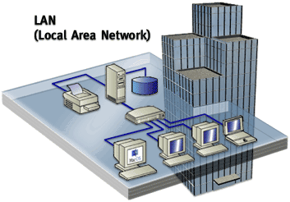
Local Area Network
A Single Building to a Campus
Radius 1m – 2-3 Km
Very High Bandwidth > 1Gbps
Immediate Access Services
File Access
Printing
E-Mail
Intranet

Slide 4
Local Area Network 2
Single Management
Ethernet Infrastructure
Local Maintenance
Usually 2 Level of LANs
Core Network
Connects Servers, Storage, etc…
Access Network
Connects Workstations

Slide 5
Wide Area Network
Between Branches / Business Partners
Country wide to Global in scope – 20,000 Km
Medium Bandwidth 1-100 Mbps
Non Time-Critical Services
File Download / Upload
E-Mail
Intranet
Internet Access

Slide 6
Wide Area Network 2
Hierarchical Management
Each Site may be managed independently
Infrastructure managed by ISP/Operator
MPLS & Other ISP Infrastructure
Distributed Maintenance

Slide 7
Wireless Networks

Slide 8
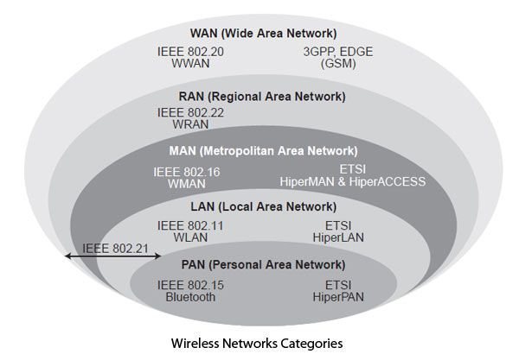
תקנים לרשתות אלחוטיות

Slide 9
IEEE 802
IEEE – International Electric & Electronic Engineers
תקני רשת – משפחת 802
http://www.ieee802.org
https://ieeexplore.ieee.org/browse/standards/get-program/page/series?id=68

Slide 10
Wireless LAN
Office to a Floor
Radius < 30m
Low to Medium Bandwidth
Lan Services
Standard | Theoretical | Actual
802.11b | 11 Mbps | 5.5 Mbps
802.11a | 54 Mbps | 20 Mbps
802.11g | 54 Mbps | 20 Mbps
802.11n | 300 Mbps | 100 Mbps
802.11ac | 7,000 Mbps | 2,100 Mbps

Slide 11
Wireless Network - Cellular
Protocols based on 3GPP
3rd Generation Partnership Project
ARIB, ATIS, CCSA, ETSI, TSDSI, TTA, TTC
Cell Radius varies
Relatively Low Bandwidth < 100Mbps
Internet Services
Mobile Network Operator provides Internet Connectivity

Slide 12
Personal Area Networks (Bluetooth)
Desk Area, Person’s Body, Car
Radius < 3m
Very Low Bandwidth < 1Mbps
Smartphones, Tablets, Laptops
Device Connectivity Services
Audio
Phone Control
Input Devices
House Alarm Sensors

Slide 13

דורות סלולאריים
דור ראשון
שנות ה-80 של המאה העשרים
קול אנלוגי
דור שני
שנות ה-90 של המאה העשרים
קול דיגיטלי
דור שלישי
סביב 2010
נתונים דיגיטליים
שירותי מיקום
דור רביעי
סביב 2015
וידאו

Slide 14
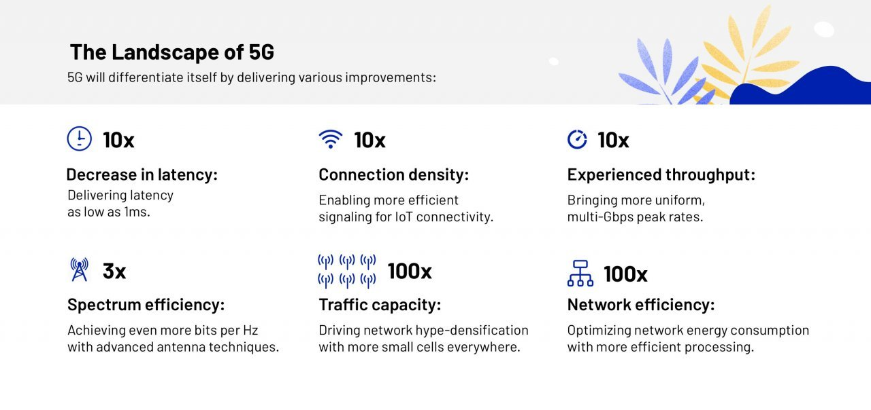
כמה מילים על הדור החמישי 5G

